Slide 1
Model Building
CRISP-DM Methodology
Jeremy Bergmann - Omaha Data Science Academy

Slide 2
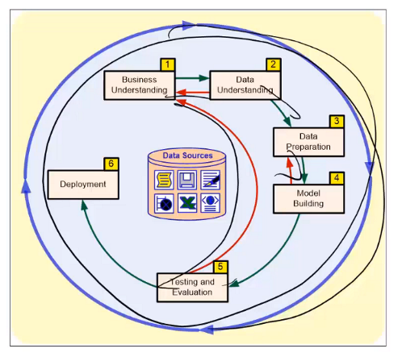
Model Deployment
CRISP-DM Process
Model deployment is the final step of the CRISP-DM process, translating the results of data science projects into business processes/activities.
Often delivered in the form of a “data product” - a product that facilitates an “end goal” through the use of data.
Data Products Include: Automated-Decision Making, Decision Support, Algorithms, derived data and/or raw data collection.
https://towardsdatascience.com/designing-data-products-b6b93edf3d23

Slide 3
Business & Data Understanding
Business Understanding
Understanding the business goal
Situation assessment/feasibility
Translating the business goal in a data mining objective
Development of a project plan
Data Understanding
Considering data requirements
Exploration & Understanding
Quality assessment
Determine “repeatability”
Leads to
Source: https://www.sv-europe.com/crisp-dm-methodology/

Slide 4
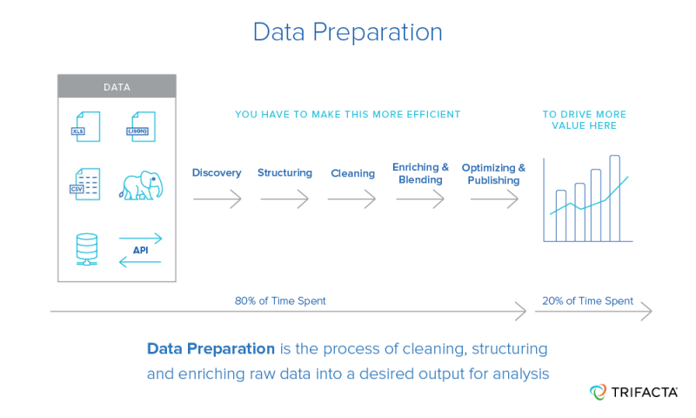
Data Preparation
Data preparation
Selection of required data
Data acquisition
Data integration and formatting
Data cleaning
Data transformation and enrichment
Data Optimization
Python Data Prep Packages
Pandas: https://pandas.pydata.org/
Numpy: https://docs.scipy.org/doc/numpy/user/quickstart.html
Notes:
Challenges in NLP: speech recognition, natural language understanding, and natural language generation.

Slide 5
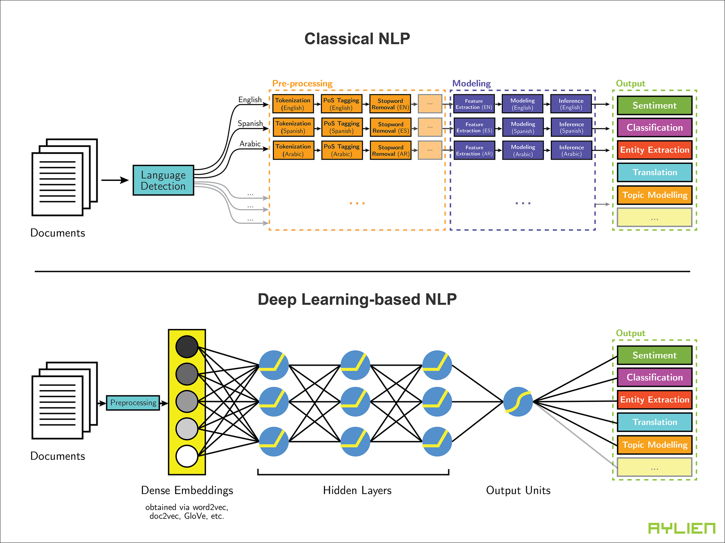
Model Building
Natural Language Processing (NLP) Modeling
Model Building
Selection of appropriate modeling technique(s)
Splitting dataset training/testing subsets for evaluation purposes
Development and examination of modeling algorithms - Model Comparison
Fine tuning model performance
https://pbs.twimg.com/media/DKhVVszUIAAUl6f.png:large
Notes:
Key difference is in goal - grouping/classification (text mining) vs. meaning & context (NLP)
NLP Introduction: https://blog.algorithmia.com/introduction-natural-language-processing-nlp/

Slide 6
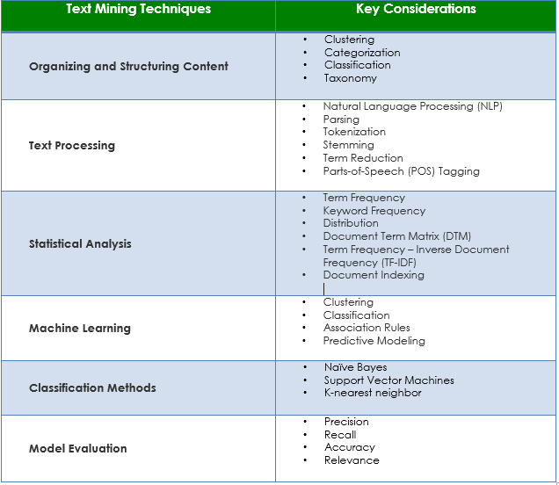
Model Testing & Evaluation
Model Testing & Evaluation
Evaluation of the model in the context of the business success criteria
Model Performance
Text Mining & NLP Model Output “Objective” and “Sense”
Model review & approval
Key: Evaluation of the model is highly depended on the modeling technique!
Notes:
Other word2vec overview links: https://skymind.ai/wiki/word2vec,
Skipgram algorithm: http://mccormickml.com/2016/04/19/word2vec-tutorial-the-skip-gram-model/

Slide 7
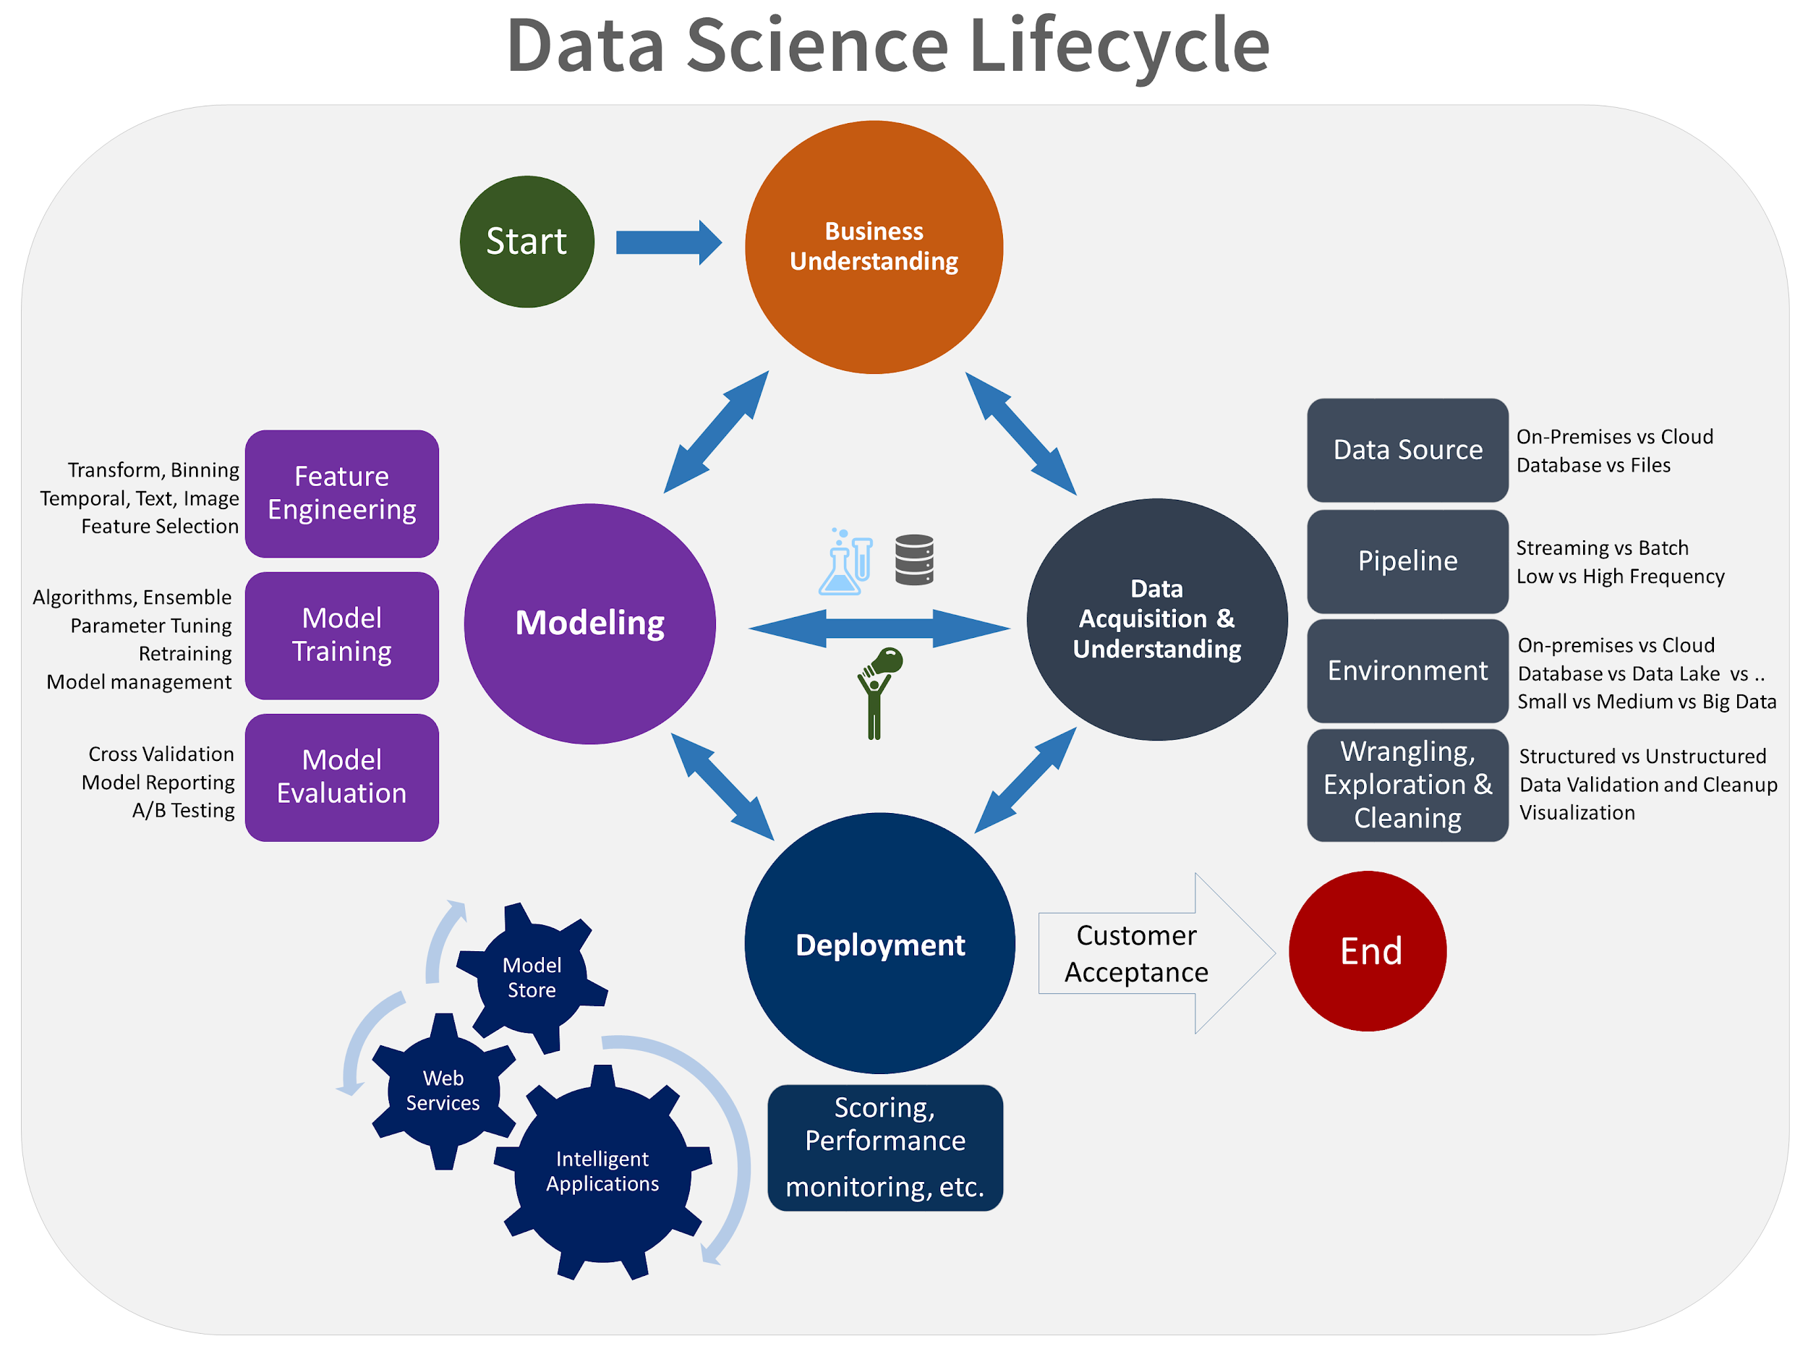
Model Deployment & Beyond
Model Deployment
Create/present report of findings
Planning and development of the deployment procedure(s)
Create Workflow and Deploy data science model
Integration into an organisation’s system(s)
Development of a maintenance / update plan
Review of the project objective & outcomes
Planning the “next steps”
Key: CRISP-DM is an iterative approach to Data Science Projects, requiring continual evaluation and improvement after deployment!
Notes:
Other word2vec overview links: https://skymind.ai/wiki/word2vec,
Skipgram algorithm: http://mccormickml.com/2016/04/19/word2vec-tutorial-the-skip-gram-model/

